Slide 1


Protect Journalists
Name | Number | Section Number
Ala’a Jamal AbdAlqader | 145335 | 1
Shaima’a Ali Bani issa | 145493 | 1
Miral Thair Dalayka | 149665 | 1
Farah Mohannad | 144156 | 1
Dr.Malak Qasaimeh.

Slide 2

Protect Journalists
“We have to protect all journalists, and journalists have to be allowed to do their jobs ”

Slide 3
TABLE OF CONTENT
Content Page
1) Introduction ……………………………………4-5
1.1 Purpose …………………………………….…..4
1.2 Context Diagram ………………………..……. 5
2) Risks …………………………………………….….6
3) Feasibility Study …………..…………………………7-10
3.1 Economical …………..………………..…….…..8-15
3.2 Technical …………………...…………….…16
3.3 Operational ………………………..………….17
3.3 LEGAL ………………………..………….18
3.3 Schedule ………………………..…………. 19-22
4) Techniques …………..………………………………...…23
5) Functional Requirements …………..………………………………...…24
6) NON-Functional Requirements …………..………………………………...…25-26
7) Context Diagram …………..………………………………...…27
8) Data flow diagram (DFD)…………..………………………………...…28-29
9) Decision table …………..………………………………...…30-32
10) Entity relational diagram (ERD): …………..………………………………...…33

Slide 4
Purpose of our project
Protect Journalists Project, is a watch and a tag that is made especially for journalists to help them to be safe and protected, mainly in critical and serious conditions like wars. The journalist will be tracked by the foundation he works to. As a result, they will help exactly on time when they need it.
Moreover, all parties involved in the war will be aware of the location of the press, in order not to obstruct their presence in any dangerous way, in an official capacity, after signing international treaties not to use this tracking in the wrong way. Journalists will be able to ask for any health service by pressing on the watch, and their health records will be provided to the nearest hospital such as blood transport or any Allergy to certain substances. Furthermore, both watch and tag will be waterproof and can’t be easily damaged, so in any condition, both will help the journalists to be safe as possible as could be.

Slide 5
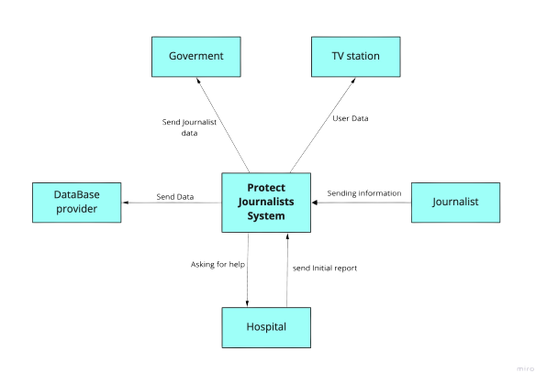
Context Diagram :

Slide 6

Risks:
Find a suitable time for all members of the group (lack of time management ).
Lack of communication among team members (can’t determine the appropriate for all members during the meeting or work ).
With all the communication channels and gadgets at our disposal, sometimes team members neglect the critical components of effective communication, leading to loss of data or misinformation and eventual project disruption.
Lack of experience and knowledge of team members, which may lead to misunderstanding of project requirements.
Low skills in using PowerPoint and UML tools.

Slide 7
Feasibility study
01
04
02
03
Economical Feasibility
Schedule
Feasibility
Technical
feasibility
05
LEGAL
FEASIBILITY
Operational feasibility

Slide 8
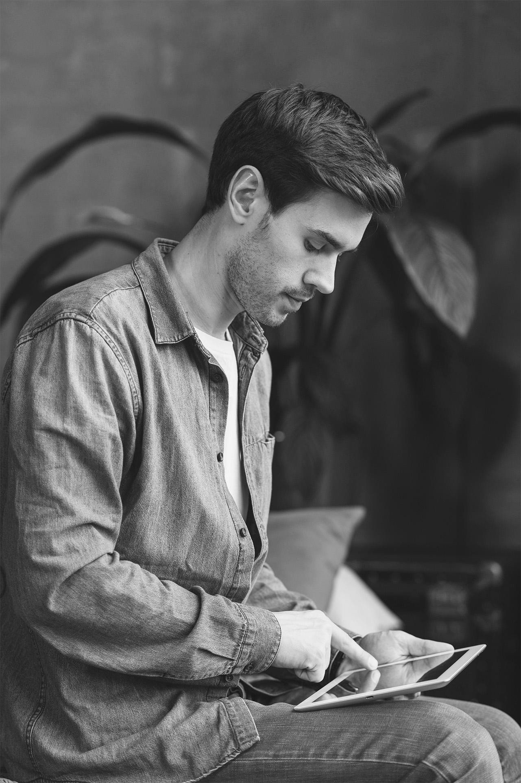
Economical feasibility:
Determine the project's expenditures and anticipated revenues.
Infrastructure (servers, internet, computers) provide.
Competitors' analyses using a comparable system.

Slide 9
Project Benefits
-Economical Feasibility: TANGIBLE BENEFITS Year 1 through 7
BENEFIT TITLE | Cost | DESCRIPTION
Cost reduction and avoidance. | 9,000$ | -Reduce the coverage of the war.
Error reduction. | 10,000$ | -Cost of equipment and consumption.
Increased flexibility. | 5,000$
Increased speed of activity. | 3,000$ | -By increasing the speed of reporting news through developing their performance and facilitating and securing their moving from place to an other.
Improvement of management planning and control. | 12,000$ | -Increasing the efficiency of the work because of the awareness of the organizer over the team’s positions
Total tangible benefits. | 39,000$ | -Increasing the field of press coverage due to the ease of operation due to safety and facilities.

Slide 10
Project Benefits
-Economical Feasibility: INTANGIBLE BENEFITS
BENEFIT TITLE
• Faster decision making.
• Availability of new, better, or more Information.
• More confidence in decision quality.
• Improved processing efficiency.
• Positive impacts on society.

Slide 11
Project Costs
-Economical Feasibility: | -Economical Feasibility: INTANGILE BENEFITS
Tangible Cost | Intangible Cost
Hardware Costs. | Operational inefficiency.
Database Cost. | Less team experience.
API Cost. | Loss of customer trust.
Testing Cost.
Operational costs.

Slide 12
Project Costs
-Economical Feasibility: TANGIBLE COSTS One-time cost Year 0.
These costs encompass activities such as: | Cost
Systems development | 14,000$
New hardware: Smart bracelet material. GPS electronics. | 10.000$
Software purchases. | 2,500$
User training. | 2,000$
Site preparation. | 4,000$
Data or system conversion. | 0
Total One-time cost | 32,500$

Slide 13
Project Costs
-Economical Feasibility: TANGIBLE COSTS Recurring cost Year 1 through 5
Examples of these costs include: | Cost
Application software maintenance. | 20,000$
Incremental data storage expenses. | 2,600$
Incremental communications. | 4,000$
Software. | 2000$
Hardware. | 1000$
Supplies and other expenses. | 0
Total Recurring cost | 29,600$

Slide 14
The initial investment of a project in year 0 amounts to 100k $ while the cash flow generated by the project will begin at 40k $ in one year and increases by 10k $ each year until year 5 Assume the Count Rate is 20% would you
Accept this project ???
Year | Date | Cash flow | Pv
0 | 31/12/2022 | 100-K | 100-K
1 | 31/12/2023 | 40 K | 33.33K
2 | 31/12/2024 | 50K | 34.72K
3 | 31/12/2025 | 60K | 34.72K
4 | 31/12/2026 | 70K | 33.75K
5 | 31/12/2027 | 80K | 32.15K
Npv = -100+168.67=68.67
Break even Point in Units = 25000/ (75-50) = 1000

Slide 15
ROI
Cost |  | Benefits ​
Category | Amount in $ | Category | Amount in $
Infrastructure | 25,000 | Reduced defect and rework | 70,000
Vendor | 18,000
Training | 12,000 | Improved cycle time | 47,500
Work effort | 50,000
Total | 105,000 | Total | 117,500
ROI = (117,500 – 105,000) / 105,000 = 11.9048%
Net Benefit = 12,500 $

Slide 16
Technical feasibility:
Related knowledge bases and journalists’ data The main functions of protected a journalists information system include:
health insurance, personnel management, staff list, attendance record, Holiday log , cost and budget management, and management of complex skills The results of research conducted in wars showed, journalist’s information systems need better technology to develop, and most of the systems implemented in terms of technology have problems,
in addition to need to know Where there is an urgent need to locate journalists accurately and alert to their presence (this is done via GPS devices) in addition to computers to follow their movement and a database to store all their movements the presence of LAN network communication and integration between systems .
Another study has stated that a network’s insufficient speed results in poor performance. Also, despite information systems being implemented for many years, there are contradictory reports of problems with these systems in the USA. In some sturdiest has been pointed out that these systems are faced with technological problems and lack of electronic communication between organizations, lack of proper hardware and software equipment and shortage of technical staff .
While other findings have stated necessary infrastructures in terms of additional equipment, a centralized network, a database to deploy a system and access to external databases as s efficient.
Therefore, in implementing systems, it is necessary to consider various factors, especially technological needs. Given that a system feasibility study and analysis leads to a better understanding of the system and ca n be used to improve health care delivery and enhance the function of each component of the system .

Slide 17
Operational & Schedule feasibility:
Operational feasibility:
is the measure of how well the project will support the customer and the service provider during the operational phase
process : input and analysis from everyone the new redesign will affect along with a data matrix on ideas and suggestions from the original plans. evaluation – determinations from the process suggestions; will the redesign benefit everyone? who is left behind? who feels threatened?
LEGAL FEASIBILITY
Laws that may restrict investment in a jurisdiction and any valuations required as a matter of law or prudent practice.
Maintenance of share capital rules that may apply, and/or whether any capital reduction may need to be carried out.
Constitutional documents of an entity that may need to be amended to allow for the intended transactions.

Slide 18

Schedule feasibility
If we run out of time, we assign assignments to team members to expedite the process. Each job is then examined individually and changed as needed.
Hold regular gatherings to work on the project with the team members and discuss the issues that will be brought up.
To complete the job on time, early planning was done.
We need to get to work on that as we still have time to complete it before the conclusion of the current semester.

Slide 19
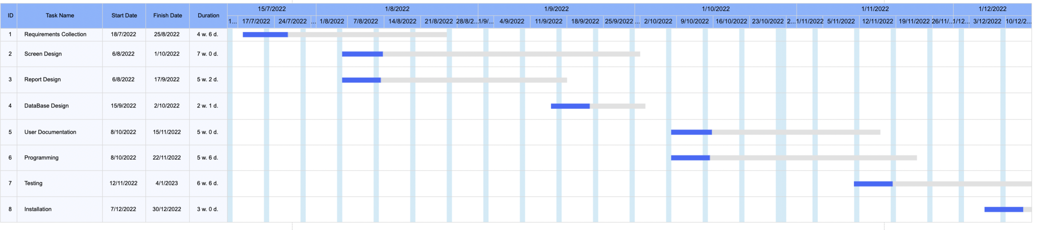
Gantt chart

Slide 20
Pert Calculation
Activity | Time Estimate (Week) O R P |  |  | Expected Time ET = (o + 4r + p)/6
Requirements Collection | 3 | 5 | 6 | 4.8
Screen Design | 5 | 7 | 9 | 7
Report Design | 4 | 5 | 7 | 5.2
Database Design | 1 | 2 | 3 | 2
User Documentation | 4 | 5 | 6 | 5
Programming | 2 | 6 | 8 | 5.6
Testing | 4 | 7 | 9 | 6.8
Installation | 3 | 3 | 3 | 3

Slide 21
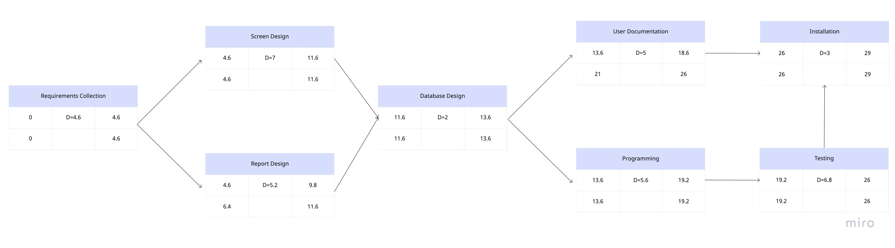
Pert chart

Slide 22
Pert chart
●Critical path : requirements collection - screen design - database design – programming - testing – installation .
●Non critical path : report design - user documentation .
● Free float of (report design and database design activities ) :
(11.6)-(4.6)-5.2=1.8.

Slide 23
Techniques
1) Interviewing individuals with journalist :
we discuss the risks they face while they are doing reports and doing press coverage.
also we explain our product to get a initial feedback or any recommendations or suggestions.
2) Observing workers (we did it by two ways) :
1- we went on tours with journalists while they were doing their work.
2- record their work in offices using cameras to see the real process.
3) We had search about many thing in google like technical feasibility study we need , what kind of project we can do and collect information about our project .

Slide 24
Functional Requirements
Admins should be able to (Administrator) :
1) Sign in and log out.
2) Access the journalist’s general information.
3) Have only access to add new users to the system.
4) Keep tracking of any journalist at any time.
The journalist should be able to
1) request for medical service at any time.
2) Log in using your fingerprint.
3) Get alert in case of an air strike is approaching
Hospitals and trusted medical canters should be able to get the journalist main health information once journalist request a medical help by QR.
Tv station : RECEIVE JOURNALIST INFORMATION
System should be able to provide offline tracking and locating journalist using sensors and wins technology.
The parties involved in the war can obtain the location of the journalist, but without informing them about their personal information.

Slide 25
Non-Functional Requirements
Security:
Each system user should have independent accessibility.
The database can be accessed only by system developers.
Privacy:
Provide the system’s main service (journalist location ) without journalist personal information.
maintainability:
Easy integration and maintenance without affecting the availability of the system.
Efficiency:
Hardware should be high quality.
Devices work with solar cells or battery that has a warranty.
Testability:
The system shall be easy to test.
The system shall be easy to report errors.

Slide 26

Non-Functional Requirements
Usability:
The system is easy to use for everyone fluent in Arabic-English, and for those who aren’t good with technology.
Recoverability:
The system should be recoverable.
The system shall backup every 24 hours.
In the situation of a system crash, the estimated loss of data shall be less than 0.01%.
Availability:
The system shall be available twenty-four hours.

Slide 27
Context Diagram :

Slide 28
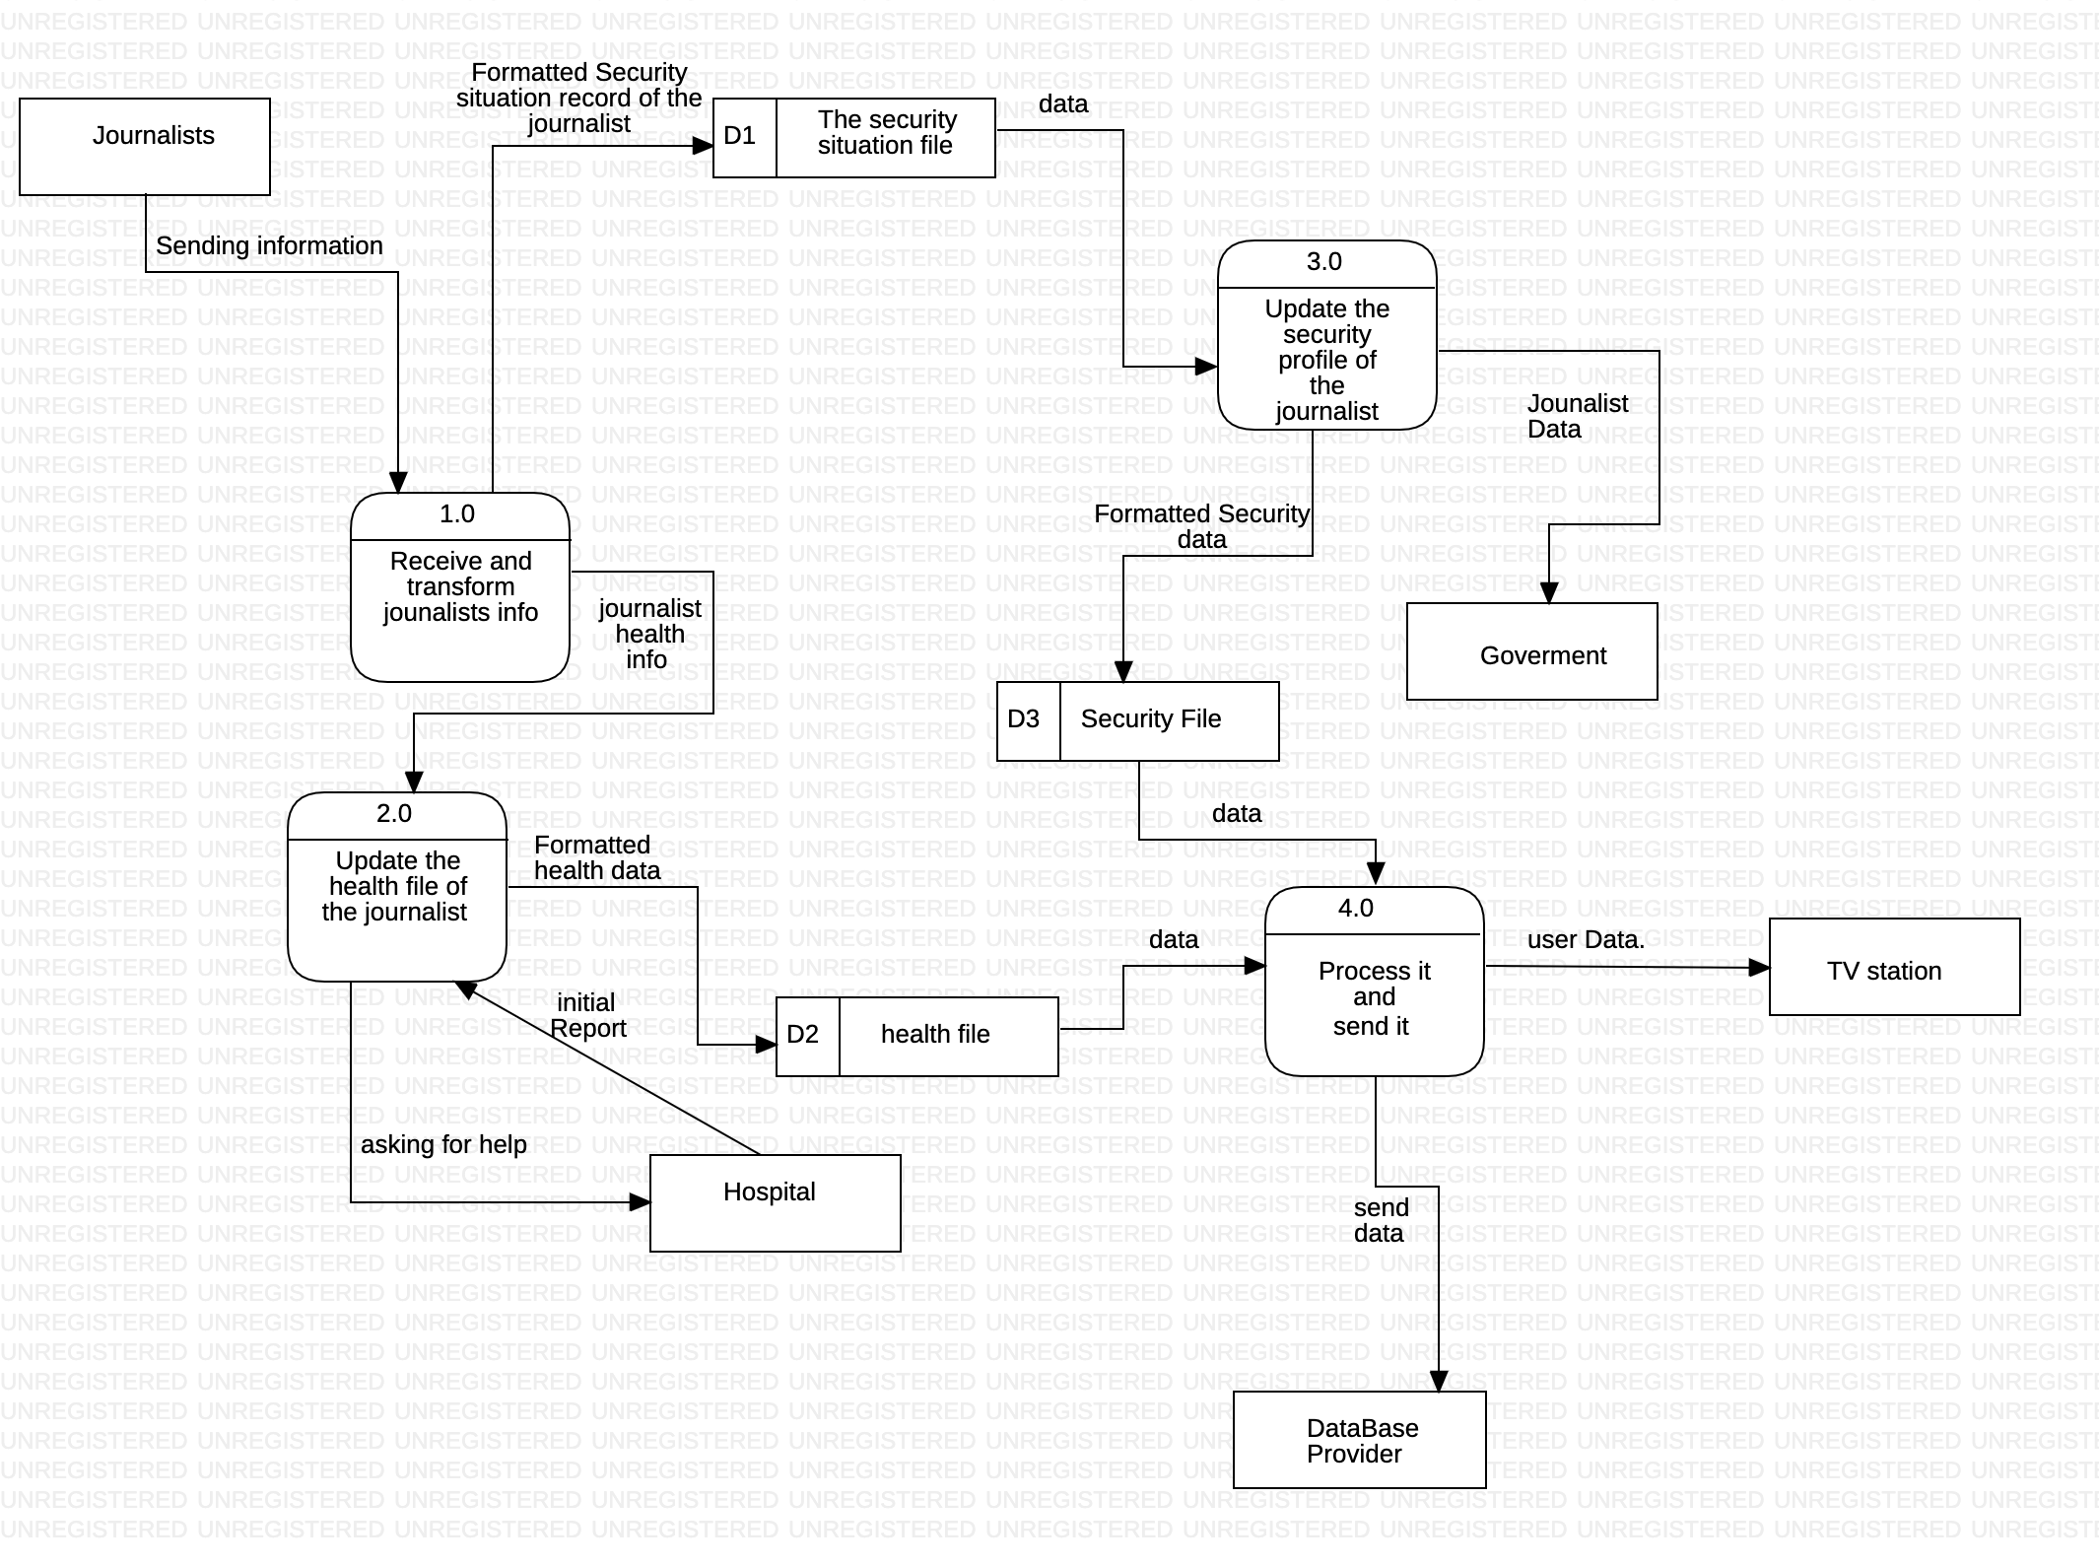
Data flow diagram (DFD):
A ) Level 0

Slide 29
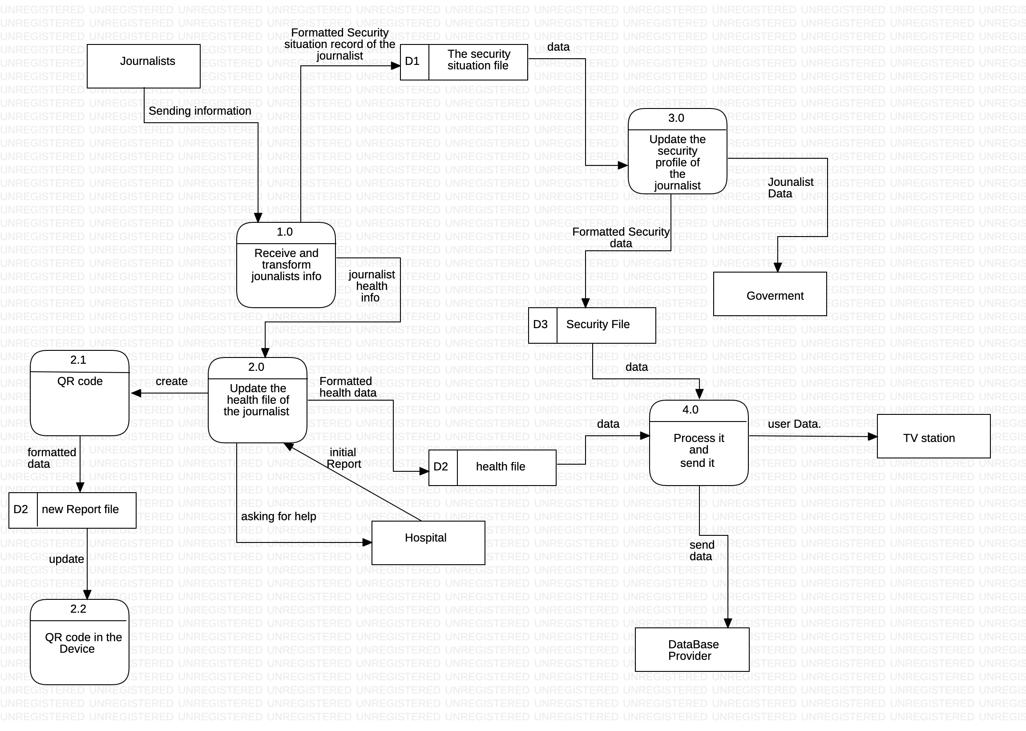
Data flow diagram (DFD):
b ) Level 1

Slide 30
decision table :
condition Stubs Action Stubs | Conditions/ Courses of Action | Rules
 |  | 1 | 2 | 3 | 4 | 5 | 6
 | Journalist Age | 35> | 35> | 35 | 35 | 35< | 35<
 | level of warfare | M | H | M | H | M | H
 | Priority in providing an urgent ambulance |  | X |  | X | X | X
 | High-level safety kit | X | X | X | X | X | X
 | level of warfare: M =medium H =high

Slide 31
decision table :
condition Stubs Action Stubs | Conditions/ Courses of Action | Rules
 |  | 1 | 2 | 3 | 4 | 5 | 6 | 7 | 8
 | Material Quality | H | L | H | L | H | L | H | L
 | Solar Cells | Y | Y | N | N | Y | Y | N | N
 | Shape | W | W | W | W | T | T | T | T
 | High Price | X | X | X |  | X
 | Increase the duration of press converge | X | X |  |  | X | X | X
 | Battery Warranty |  |  | X | X |  |  | X | X
 | Material Quality : H=high quality , L=low quality . Solar Cells : Y =yes include solar cells , N= no include solar cells. Shape : W= watch , T=tag .

Slide 32
Simplifying decision table :
condition Stubs Action Stubs | Conditions/ Courses of Action | Rules
 |  | 1 | 4 | 5 | 8
 | Material Quality | H | L | H | L
 | Solar Cells | Y | N | Y | N
 | Shape | W | W | T | T
 | High Price | X |  | X
 | Increase the duration of press converge | X |  | X
 | Battery Warranty |  | X |  | X

Slide 33
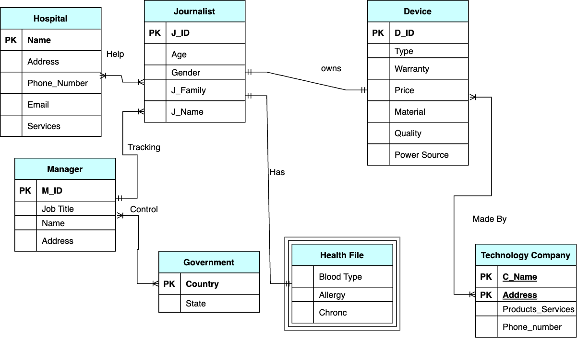
Entity relational diagram (ERD):

Slide 34
Type of testing we use the white box

Slide 35
Condition | Valid partitions | Tag | Invalid partitions | Tag | Valid boundaries | Tag | invalid boundaries | Tag
Username | 2-15 charters | V1 | >64 Invalid varchars Null | T1 T2 T3 | 2 varchars 64 varchars | A1 A2 | 1 varchar 65 varchars | B1 B2
Full name | 4-64 varchars | V2 | >64 Invalid varchars Null | T4 T5 T6 | 4 varchars 64 varchars | A3 A4 | 1 varchar 65 varchars | B3 B4
email | 2-64 varchars | V3 | Not found “@” and ’’.’’ >64 Invalid varchars Null | T7 T8 T9 T10 | 2 varchars 64 varchars | A5 A6 | 1 varchar 65 varchars | B5 B6
password | 8-32 varchars | V4 | <8 | T11 | 8 varchars | A7 | 7 varchars | B7
 |  |  | >32 Invalid varchars | T12 | 32 varchars | A8 | 33 varchars | B8
 |  |  | Null | T13
 |  |  |  | T14
Phone number | 10 digits only | V5 | >10 | T15 | 10 digits | A9 | 11 digits | B9
 | Start with |  | <10 | T16 | Start with | A10 | 9 digits MORE THAN 11 | B10 B15
 | [078,079,077] |  | NO digit | T17 | [078,079,077]
 |  |  | Not begin with | T18
 |  |  | 07
Select Gender | Male, Female | V6 | Null | T19 | Male, Female | A11 | Null | B11
Select Countries | JO, USA...Etc | V7 | Null | T20 | JO, USA...Etc | A12 | Null | B12
Enter City | 2-64 varchars | V8 | >64 Null Invalid varchars | T21 T22 T23 | 2 varchars 64 varchars | A13 A14 | 1 varchar 65 varchars | B13 B14

Slide 36
Test case | Description | Expected outcome | Tags cover
1 | Username: Alaa Full name: Alaa jamal Abdalqader Email: AlaaJamal@gmail.com Password: Alaa123456 Phone number: 0797013327 Select Gender: Female Select Countries: JO Enter City: Amman | Pass | V1, V2, V3, V4, V5, V6, V7, V8, A1, A3, A5,A7, A9,A11, A13, A15
2 | Username:rahaf Full Name: rahaf sammah Email:Rahaf@gmail.com Password: Rahf122323 Phone number: Select Gender: Select Countries:USA Enter City: Amman | Fail | V1V2V3V4V7V8 T17,T19 A2,A4,A6,A8,A12,A14 B11

Slide 37
Test case | Description | Expected outcome | Tags cover
3 | Username: FullName:alucbycybyguybuyvbuyvbdfvyuregvuerygvugvyuergveygvygyvguygvyegvyergvygvyrgyvguyvyvgyrgvyrgvyryvygvygvyrgvygygvyrgvygerygyrvgryvuttfrrdrftyufyfytftfy. Email: Alagyrgeuefgrgrwtmnbvfdrtgmail.com Password: ajh87yerher778erw7wev87rv7rvyrr87h7reh7e7vre8vrevrevr Phone number: 2098918827 Select Gender: Select Countries: EnterCity: joradnbudaygcyuregygvyugyvvuevFGERERGgreyg | Fail | T3,T4,T7,T14,T18,T19,T20,T23 B2,B4,B6,B8,B10,B11,B12,B14
4 | Username:A Full Name: J Email:A Password: ALAA12 Phone number:793331432 Select Gender: Select Countries: Enter City: J | Fail | T1, T4, T7, T8, T11, T16, T18, T19, T20, B1, B3, B5, B7, B10, B11, B12, B13, B15

Slide 38
Test case | Description | Expected outcome | Tags cover
5 | Username:ALAA FullName: Email: Password: Phone number: Select Gender: Fmale Select Countries:Jo EnterCity: | Fail | V1,T6T10,T14,T17,V6,V7,T22, A2,B11,B12
6 | Username:alaa Full Name: jaml43245%%3$5$% Email:alaanadakj88####u9 Password: 8784238472sdjiudh(^4@@ Phone number:0328087834343242332423432423432423423 Select Gender: Select Countries: Enter City: | Fail | V1,T5,T7,T9 ,T13,T15,T18, T19,T20,T22 A2,B15,B11,B12

Slide 39

“A picture is worth a thousand words”

